Slide 1
Unit-1
Introduction to Basics

Slide 2
R-Programming
R is a programming language and software environment for statistical analysis, graphics representation and reporting. R was created by Ross Ihaka and Robert Gentleman at the University of Auckland, New Zealand, and is currently developed by the R Development Core Team.
R was initially written by Ross Ihaka and Robert Gentleman at the Department of Statistics of the University of Auckland in Auckland, New Zealand. R made its first appearance in 1993.

Slide 3
Features of R
R is a well-developed, simple and effective programming language which includes conditionals, loops, user defined recursive functions and input and output facilities.
R provides a suite of operators for calculations on arrays, lists, vectors and matrices.
R provides a large, coherent and integrated collection of tools for data analysis.
R provides graphical facilities for data analysis and display either directly at the computer or printing at the papers.

Slide 4
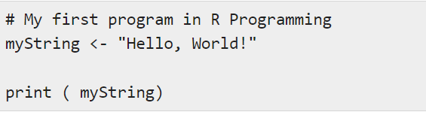
First Program

Slide 5
Data Types
In contrast to other programming languages like C and java in R, the variables are not declared as some data type. The variables are assigned with R-Objects and the data type of the R-object becomes the data type of the variable. There are many types of R-objects. The frequently used ones are −
Vectors
Lists
Matrices
Arrays
Factors
Data Frames

Slide 6
The other R-Objects are built upon the atomic vectors.
Data Type | Example | Verify
Logical | TRUE, FALSE | v <- TRUE print(class(v)) it produces the following result − [1] "logical"
Numeric | 12.3, 5, 999 | v <- 23.5 print(class(v)) it produces the following result − [1] "numeric"

Slide 7
Integer | 2L, 34L, 0L | v <- 2L print(class(v)) it produces the following result − [1] "integer"
Complex | 3 + 2i | v <- 2+5i print(class(v)) it produces the following result − [1] "complex"
Character | 'a' , '"good", "TRUE", '23.4' | v <- "TRUE" print(class(v)) it produces the following result − [1] "character"

Slide 8
Variables
A variable provides us with named storage that our programs can manipulate. A valid variable name consists of letters, numbers and the dot or underline characters. The variable name starts with a letter or the dot not followed by a number.
Variable Name | Validity | Reason
var_name2. | valid | Has letters, numbers, dot and underscore
var_name% | Invalid | Has the character '%'. Only dot(.) and underscore allowed.
2var_name | invalid | Starts with a number

Slide 9
.var_name, var.name | valid | Can start with a dot(.) but the dot(.)should not be followed by a number.
.2var_name | invalid | The starting dot is followed by a number making it invalid.
_var_name | invalid | Starts with _ which is not valid

Slide 10
Variable Assignment
The variables can be assigned values using leftward, rightward and equal to operator.
The values of the variables can be printed using print() or cat() function.
The cat() function combines multiple items into a continuous print output.

Slide 11
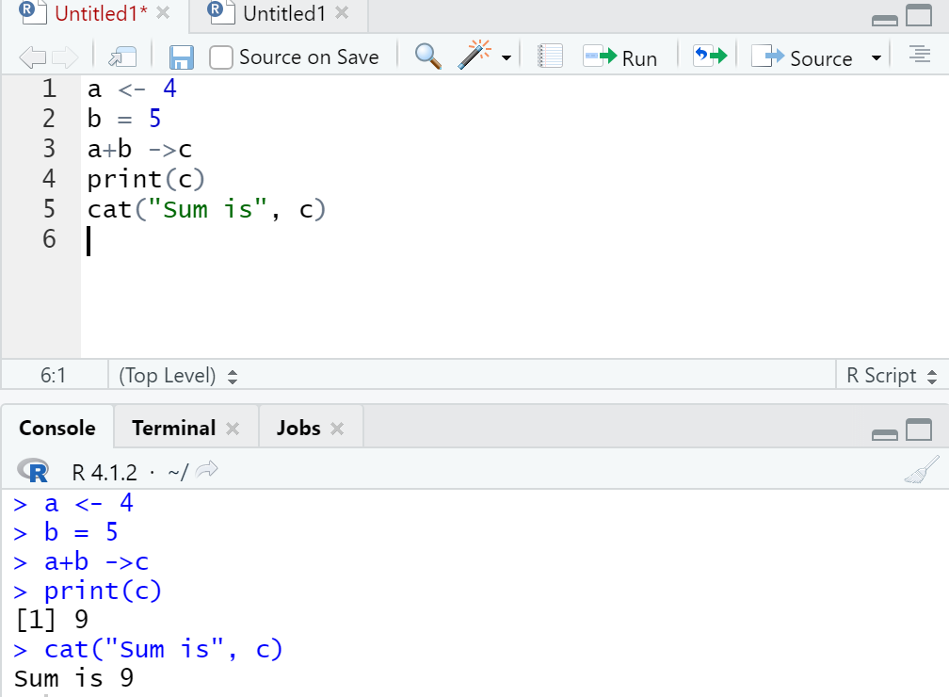
Example
Program to show the Variable Assignment and print() and cat ()

Slide 12
Data Type of a Variable
In R, a variable itself is not declared of any data type, rather it gets the data type of the R - object assigned to it.
So R is called a dynamically typed language, which means that we can change a variable’s data type of the same variable again and again when using it in a program.
To know all the variables currently available in the workspace we use the ls() function.
print(ls())
Also the ls() function can use patterns to match the variable names.
print(ls(pattern = "a"))

Slide 13
Variables can be deleted by using the rm() function.
abc = 15
rm(abc)
All the variables can be deleted by using the rm() and ls() function together.
rm(list=ls())
print(ls())

